Slide 1
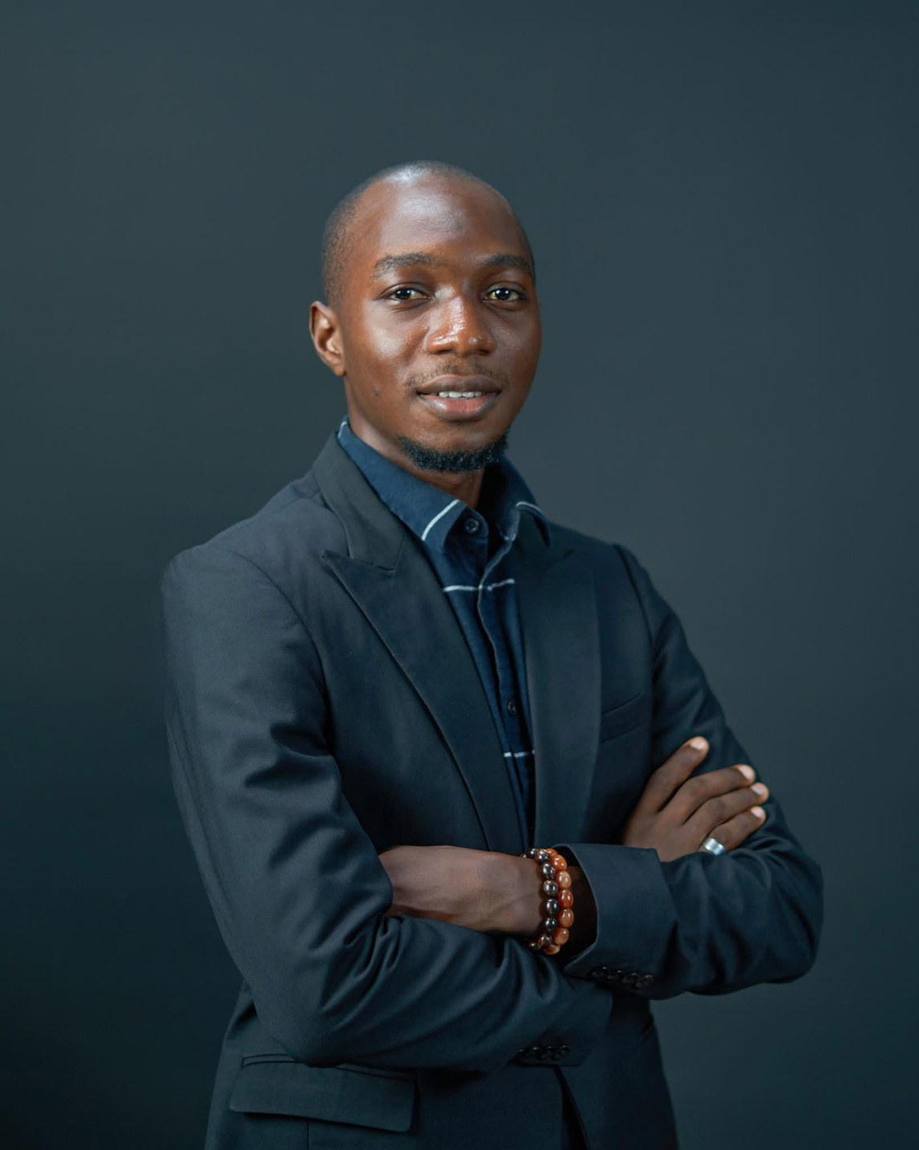

Adelalu Wahab
Home
Photo
About Me
Contact
My Portfolio
I am an emerging environmental researcher with a strong focus on geospatial science and climate policy. My work explores practical solutions to pressing environmental challenges across Nigeria.
Explore Now
Play Video
Page | 01

Slide 2
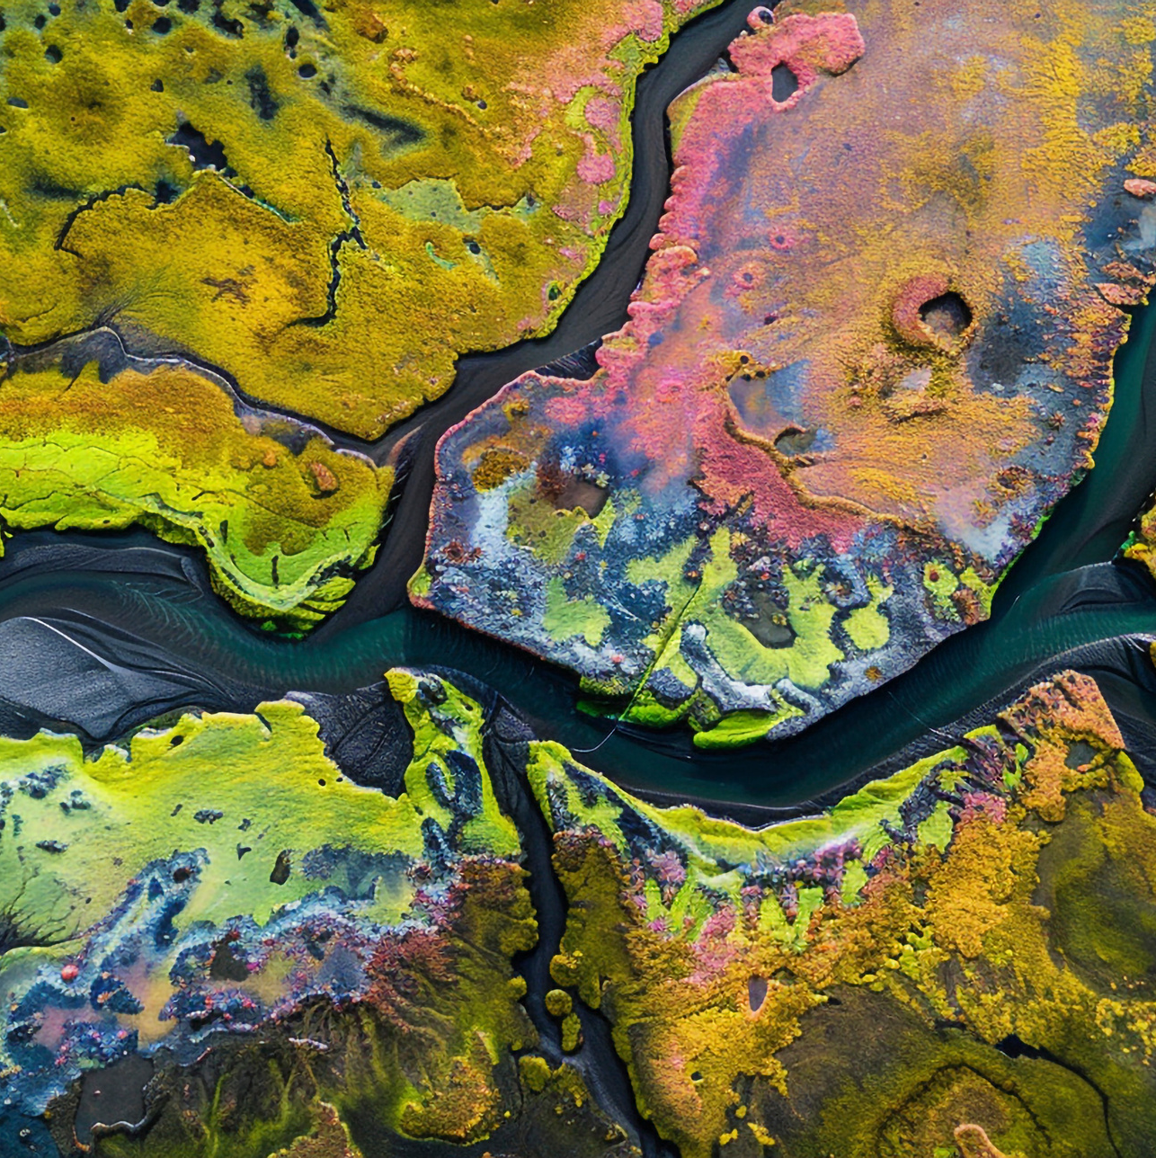
Adelalu Wahab
Home
Photo
About Me
Contact
Introduction
I am an emerging environmental researcher with a strong interest in environmental policy, climate action, and geospatial science. My academic and professional journey reflects a commitment to addressing environmental challenges affecting communities in Nigeria and across Africa. Through continuous learning, research, and field experience, I aim to contribute to sustainable solutions that improve environmental resilience and support national development.
About Me
About Portfolio
I hold a degree in Geography and Regional Planning from Olabisi Onabanjo University, complemented by practical experience in GIS, remote sensing, and environmental analysis. Over the years, I have developed a multidisciplinary skill set that spans environmental assessment, climate policy, and geospatial data interpretation. I am passionate about using evidence-based research and innovative tools to support environmental decision-making, planning, and sustainable development initiatives.
This portfolio showcases selected academic work, research projects, geospatial analyses, and environmental policy contributions that reflect my growth and interests as a scholar. Each piece highlights my ability to apply analytical thinking, technical skills, and environmental understanding to real-world challenges. The collection demonstrates both my academic foundation and my dedication to creating impactful, sustainable solutions.
Page | 02

Slide 3
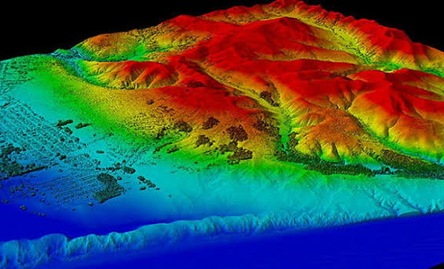
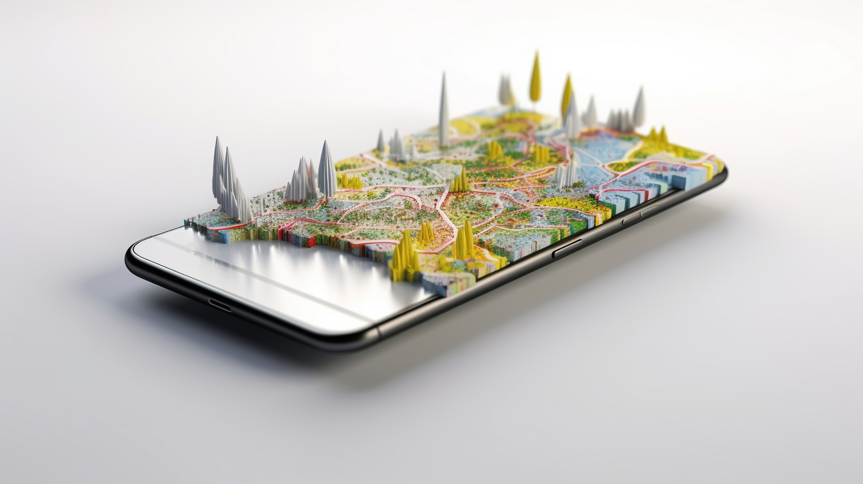
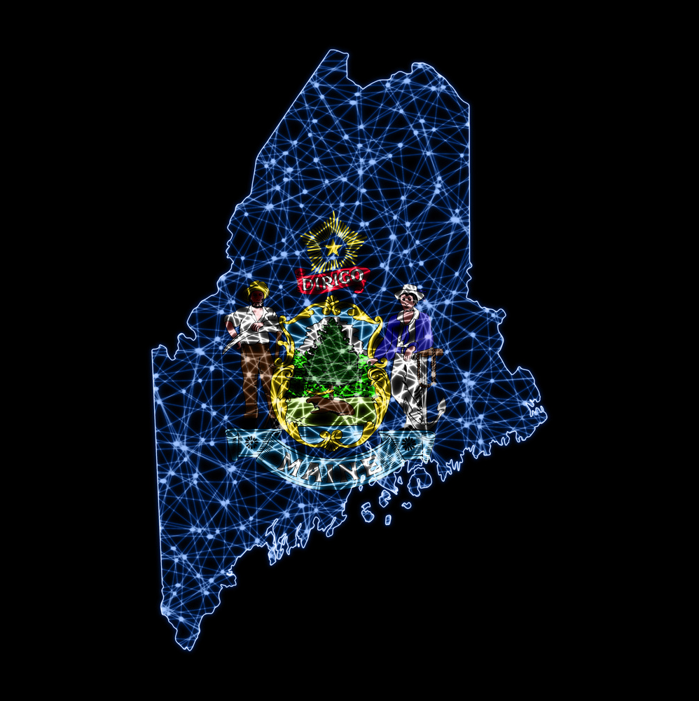
Adelalu Wahab
Home
Photo
About Me
Contact
About Me
My Vision
My Mission
To contribute to a sustainable, climate-resilient Africa where environmental policy, scientific research, and community development work together to protect ecosystems and improve quality of life.
To leverage advanced environmental and geospatial knowledge to support evidence-based policy-making, drive climate solutions, and create practical tools that empower communities, institutions, and governments to make informed environmental decisions.
Page | 03

Slide 4


Adelalu Wahab
Home
Photo
About Me
Contact
My Vision
01.
To advance evidence-based environmental policies that protect ecosystems, support sustainable growth, and improve the well-being of vulnerable populations, while helping to build strong research capacity within the environmental sector.
02.
To integrate geospatial science, climate knowledge, and mentorship into national development planning, enabling stronger disaster preparedness, professional growth, climate resilience, and responsible resource management.
Page | 04

Slide 5
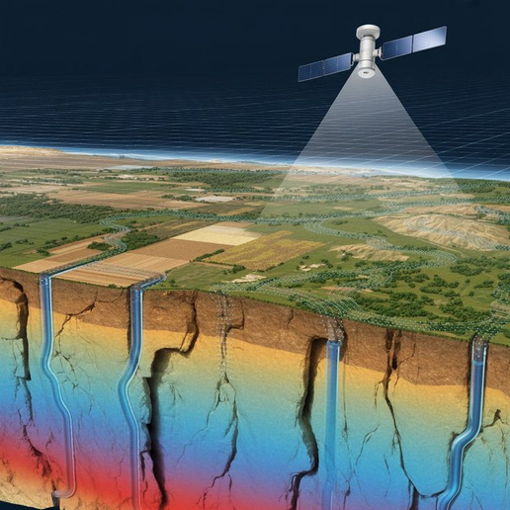
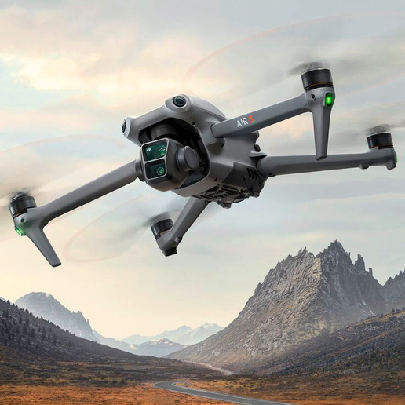
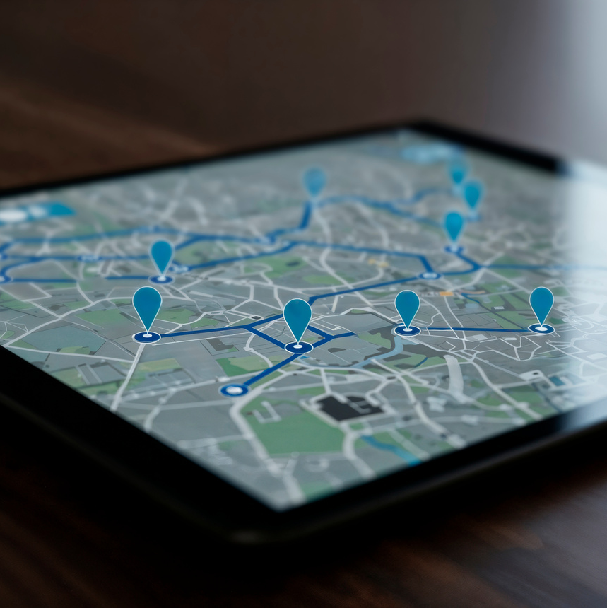

Adelalu Wahab
Home
Photo
About Me
Contact
My Mission
01.
To contribute to evidence-based environmental policy by transforming complex data into accessible insights for governments, institutions, and communities.
02.
To leverage geospatial science, AI, and machine learning to analyse environmental patterns, improve decision-making, and support climate adaptation strategies.
03.
To build research capacity, foster collaboration, and mentor emerging scholars and practitioners in environmental science and geospatial technology.
04.
To promote sustainable development by applying innovative digital tools, climate knowledge, and interdisciplinary approaches to solve environmental challenges and improve community resilience.
Page | 05

Slide 6
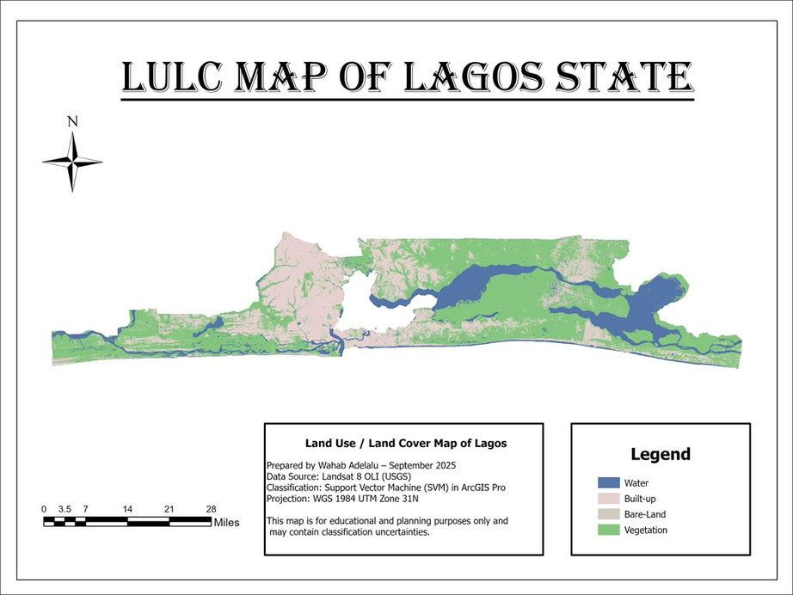
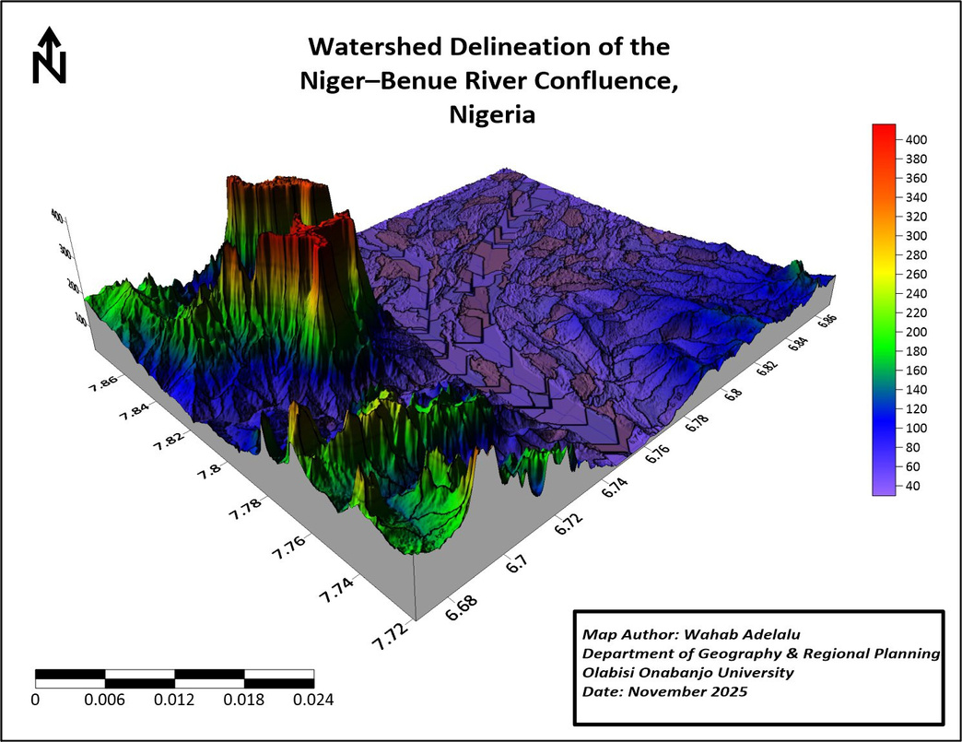
Adelalu Wahab
Home
Photo
About Me
Contact
My Favorite Portfolio
Page | 06

Slide 7
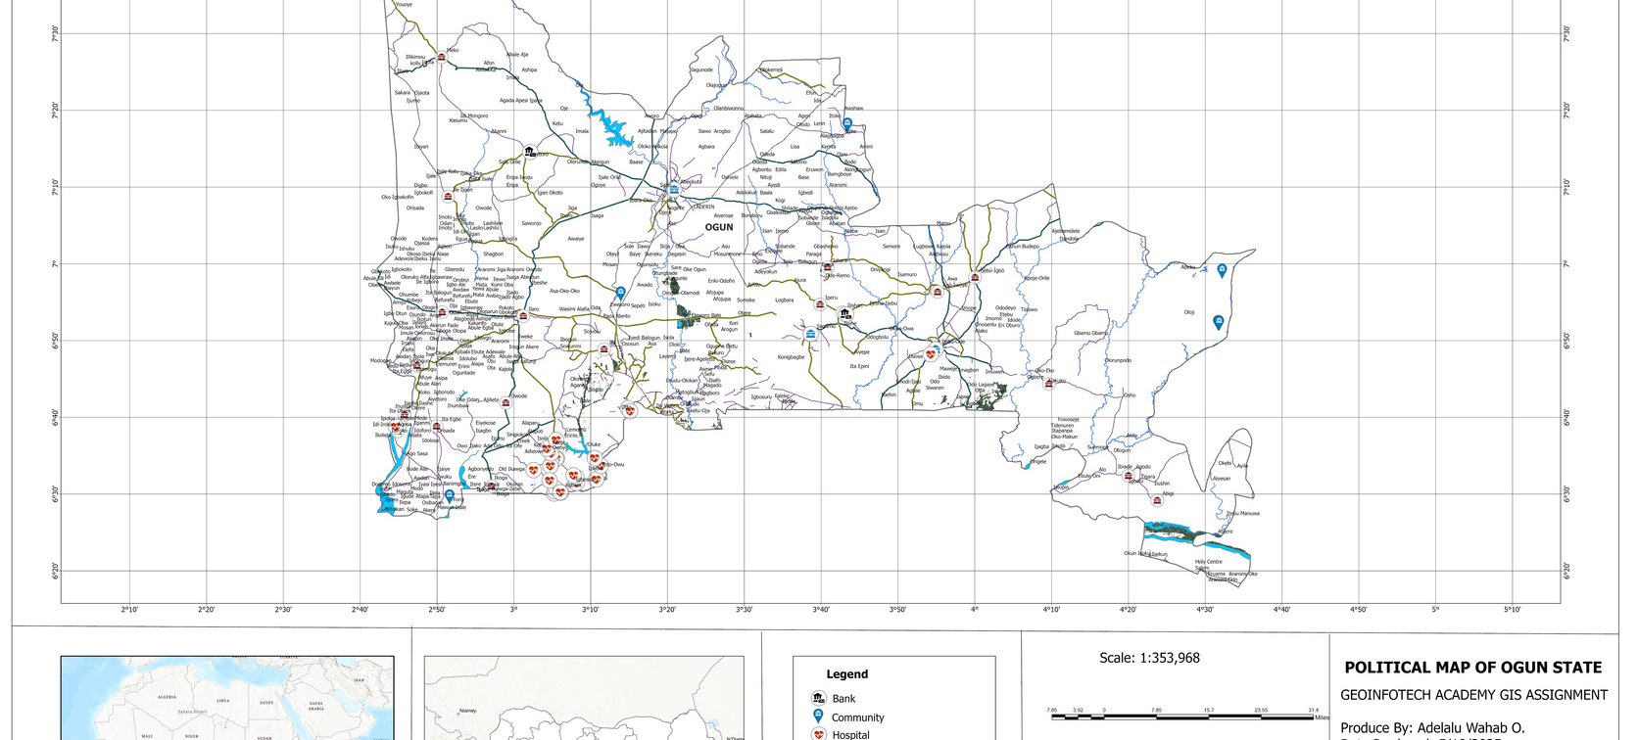

Adelalu Wahab
Home
Photo
About Me
Contact
My Portfolio
These are examples of web applications and interactive maps I have developed. You can explore more of my projects on my GitHub "https://github.com/Olamilekan5177"
and in my online portfolio "https://t.co/lUpaVGA10Q" .
Page | 08

Slide 8
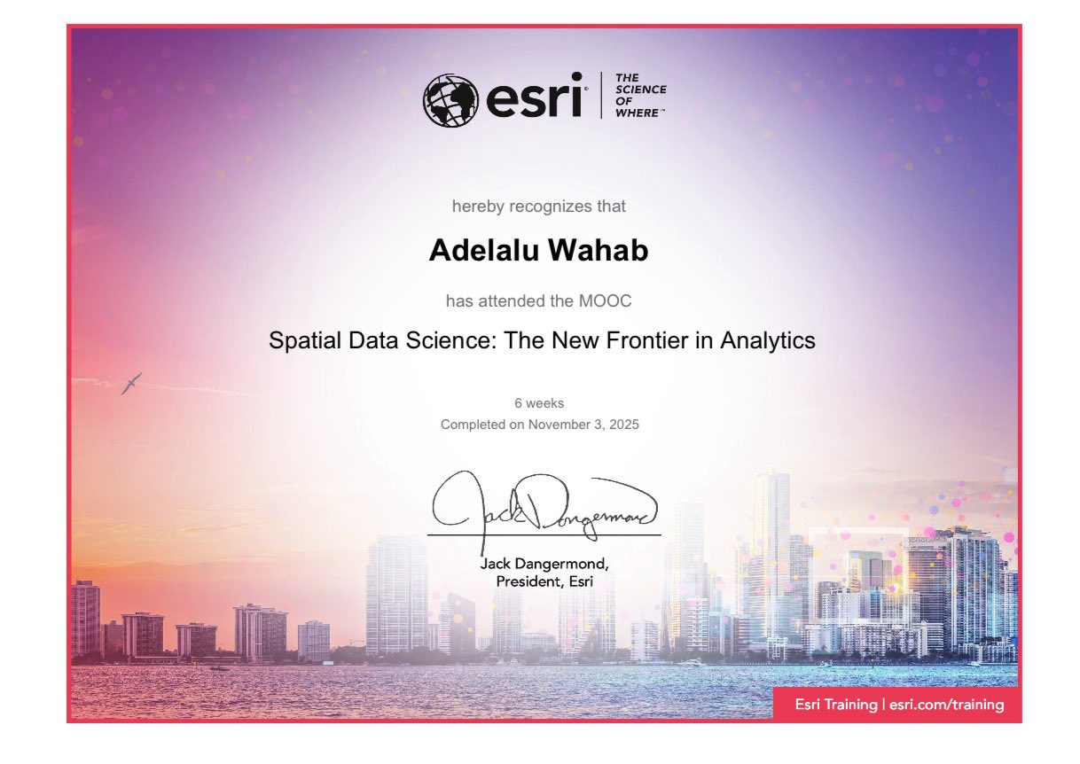
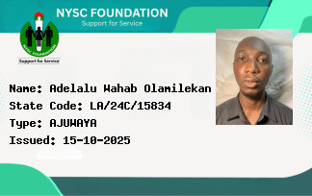
Adelalu Wahab
Home
Photo
About Me
Contact
My Certifications
Page | 09

Slide 9
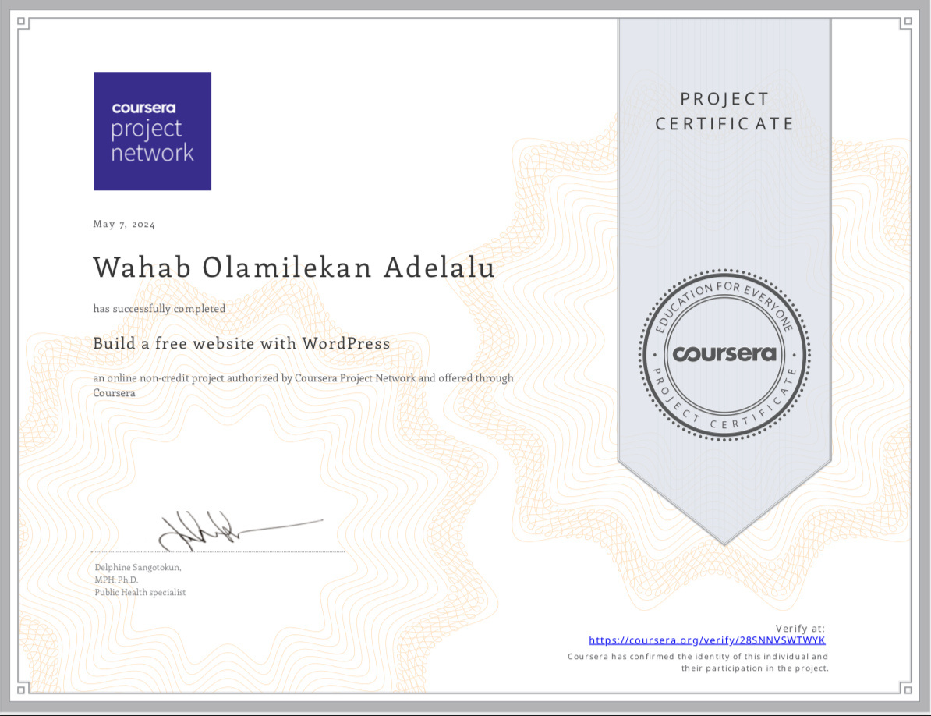
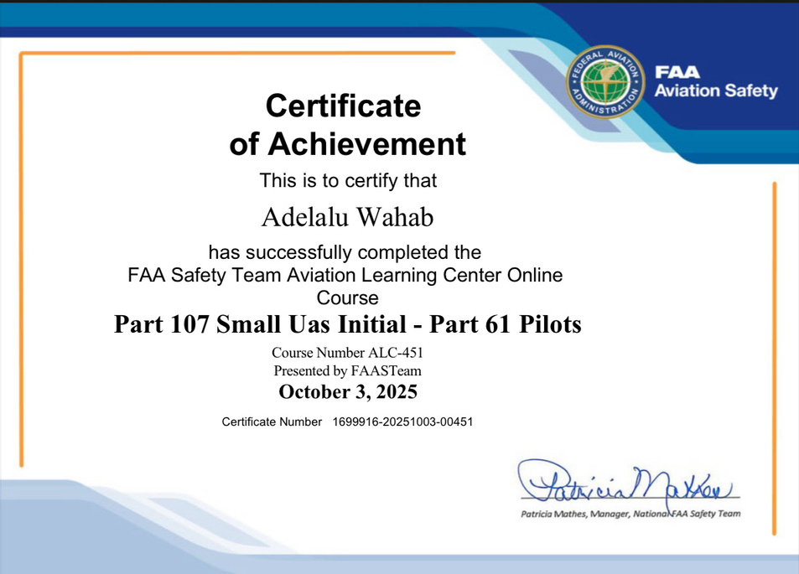
Adelalu Wahab
Home
Photo
About Me
Contact
My Certifications
Page | 10

Slide 10
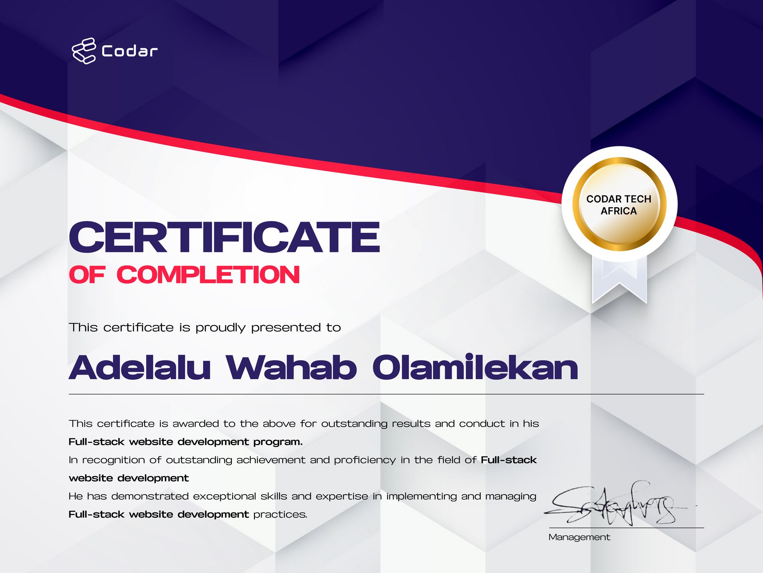
Adelalu Wahab
Home
Photo
About Me
Contact
My Certifications
Page | 11

Slide 11




Adelalu Wahab
Home
Photo
About Me
Contact
My Contact
I am open to discussing my work in environmental research, geospatial analysis, and web applications, and I welcome opportunities for collaboration, knowledge exchange, and engagement with professionals, researchers, and organizations in the environmental and technology sectors.
+234-8026235177
https://t.co/lUpaVGA10Q
Adelaluwahab@gmail.com
12, Ojubanire Street, Agbado Crossing, Lagos State
Page | 12

Slide 12

Adelalu Wahab
Home
Photo
About Me
Contact
Thank You
Thank you for taking the time to review my portfolio — I promise it’s not just my work that’s impressive; I’m funny too! I look forward to sharing ideas, collaborating, and hopefully making both an impact and a few laughs along the way.
Page | 13

